Slide 1
Chapter 1
An introduction to Python programming

Slide 2
Applied objectives
Use IDLE to test Python expressions and statements in the interactive shell.
Use IDLE to open, compile, and run a Python source file.

Slide 3
Knowledge objectives
List three reasons why Python is a good first language for new programmers.
Describe a console program.
Explain how Python compiles and runs a program in terms of source code, bytecode, and the virtual machine.
Explain how main memory and disk storage work together when a program is running.
Distinguish between systems software and application software.
Distinguish between testing and debugging.
Distinguish between syntax errors and runtime errors.
Describe an exception.

Slide 4
Four general-purpose programming languages
C++
Java
C#
Python

Slide 5
The Python timeline
Year | Month | Release
2000 | October | 2.0
2008 | December | 3.0
2010 | July | 2.7
2015 | September | 3.5

Slide 6
Syntax differences between Python and Java
Some Java code
private static double calculateFutureValue(
double monthlyInvestment,double monthlyRate, int months) {
double futureValue = 0.0;
for (int i = 1; i <= months; i++) {
futureValue =
(futureValue + monthlyInvestment) * (1 + monthlyRate);
}
return futureValue;
}
Python code that works the same
def calculateFutureValue(monthlyInvestment, monthlyRate, months):
futureValue = 0.0
for i in range(months):
futureValue =
(futureValue + monthlyInvestment) * (1 + monthlyRate)
return futureValue

Slide 7
Why Python is a great first language
Python has a simple syntax that’s easier to read and use than most other languages.
Python has most of the features of traditional programming languages. As a result, you can use Python to learn concepts and skills that apply to those languages too.
Python supports the development of a wide range of programs, including games, web applications, and system administration.
Python is used by many successful companies, including Google, IBM, Disney, and EA Games. As a result, knowing Python is a valuable skill.
Python is open source. There are many advantages to being open source.

Slide 8
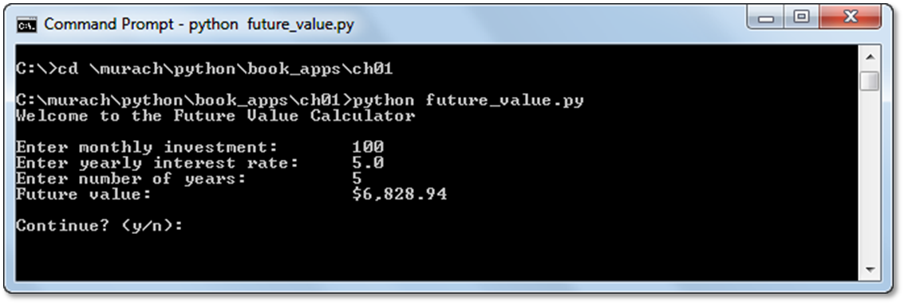
A console application

Slide 9
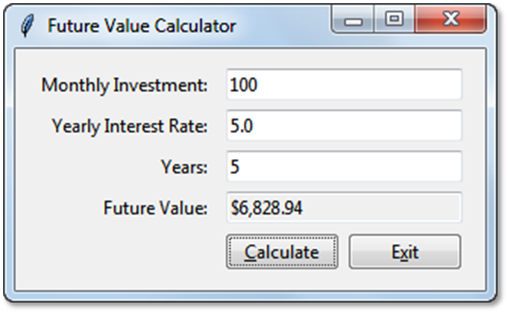
A GUI application

Slide 10
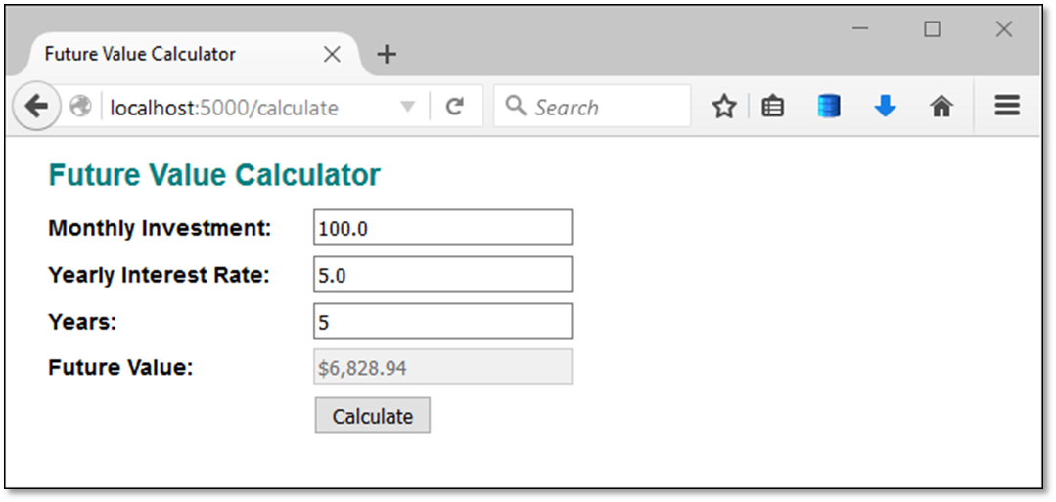
A web application

Slide 11
The source code for a console application (part 1)
#!/usr/bin/env python3
import locale
# set the locale for use in currency formatting
result = locale.setlocale(locale.LC_ALL, '')
if result == 'C' or result.startswith('C/'):
locale.setlocale(locale.LC_ALL, 'en_US')
# display a welcome message
print("Welcome to the Future Value Calculator")
print()
choice = "y"
while choice.lower() == "y":
# get input from the user
monthly_investment = float(input("Enter monthly investment:\t"))
yearly_interest_rate = float(input("Enter yearly interest rate:\t"))
years = int(input("Enter number of years:\t\t"))
# convert yearly values to monthly values
monthly_interest_rate = yearly_interest_rate / 12 / 100
months = years * 12

Slide 12
The source code for a console application (part 2)
# calculate the future value
future_value = 0
for i in range(months):
future_value = future_value + monthly_investment
monthly_interest_amount = future_value * monthly_interest_rate
future_value = future_value + monthly_interest_amount
# format and display the result
print("Future value:\t\t\t" + locale.currency(
future_value, grouping=True))
print()
# see if the user wants to continue
choice = input("Continue? (y/n): ")
print()
print("Bye!")

Slide 13
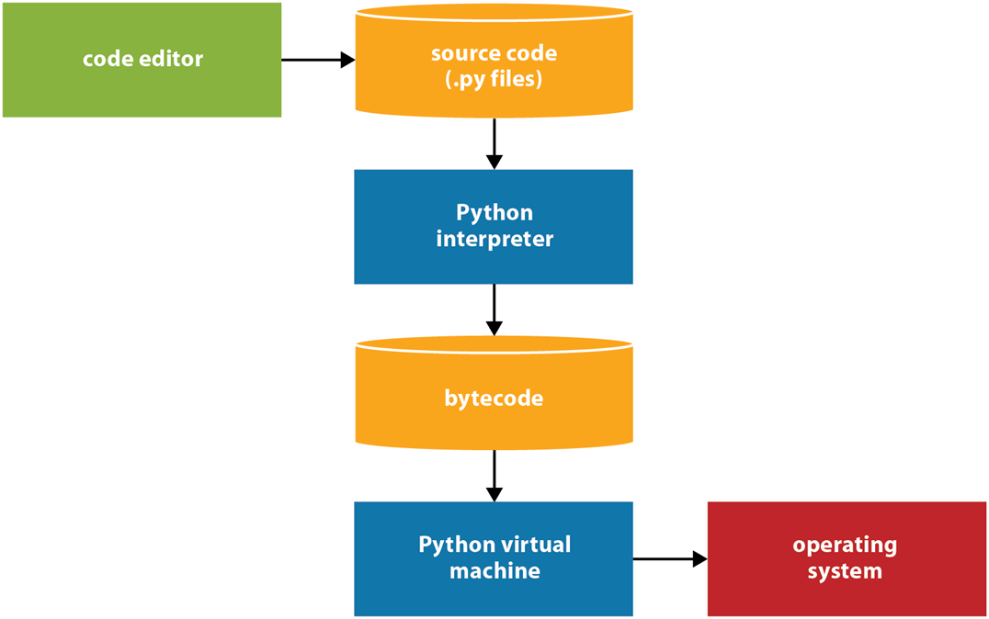
How Python compiles and runs source code

Slide 14
Procedure
Step 1 The programmer uses a text editor or IDE to enter and edit the source code. Then, the programmer saves the source code to a file with a .py extension.
Step 2 The source code is compiled by the Python interpreter into bytecode.
Step 3 The bytecode is translated by the Python virtual machine into instructions that can interact with the operating system of the computer.

Slide 15
Main memory and disk storage as an application runs

Slide 16
How disk storage and main memory work together
When you start the computer, it loads the operating system into main memory. Then, you use the features of the operating system to start an application.
When you start an application, the operating system loads it into main memory. Then, it runs the application.
As the application runs, it may read data from disk storage into main memory or write data from main memory to disk storage.

Slide 17
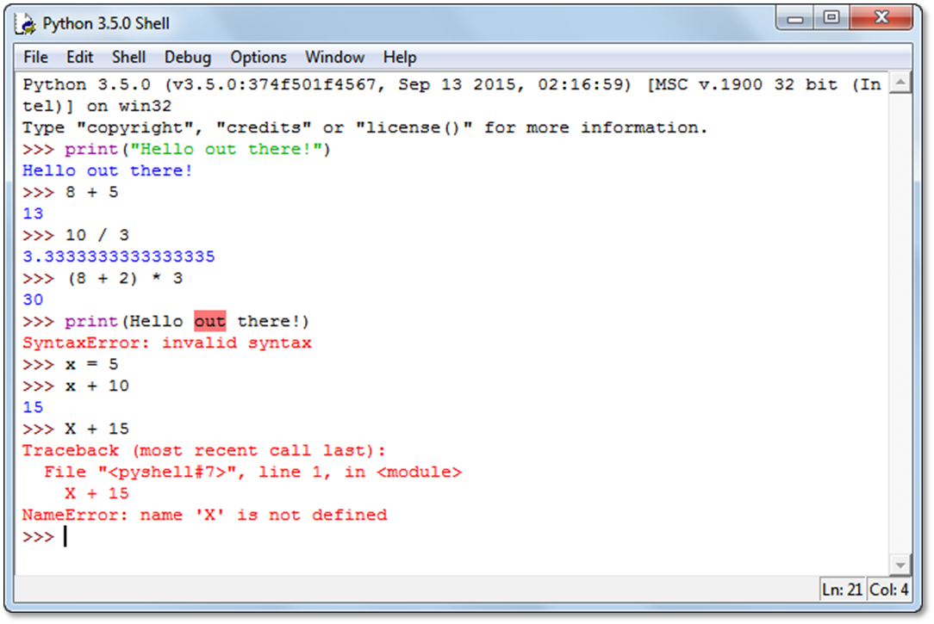
IDLE’s interactive shell

Slide 18
How to open, close, and restart the shell
To start IDLE, use the features of your operating system. This opens an interactive shell.
To close the interactive shell, click on its close button or select File→Close.
To restart an interactive shell, select Run→Python Shell from an interactive shell window.

Slide 19
How to use the interactive shell
Enter Python code after the >>> prompt. Then, press Enter.
If you enter valid code that produces a result, the shell displays the result.
If you enter an invalid code, the shell displays an error message.

Slide 20
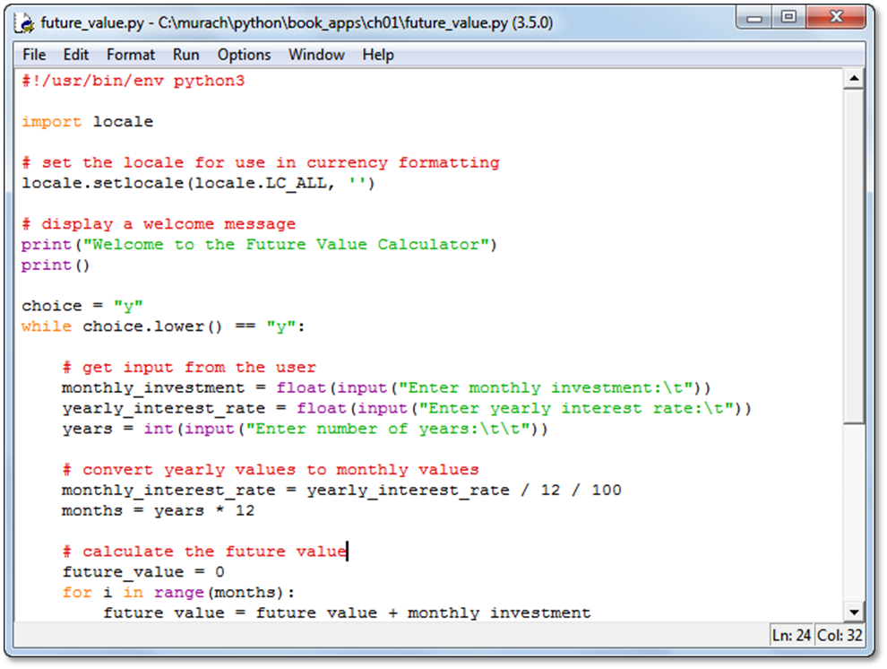
IDLE’s editor with a source file displayed

Slide 21
How to create, open, save, and close source files
Use IDLE’s File menu and common techniques for your operating system.
How to switch between source and shell windows
Use IDLE’s Window menu.
How to enter and edit Python code
Use IDLE’s Edit and Format menus, common editing keystrokes, and context menus.

Slide 22
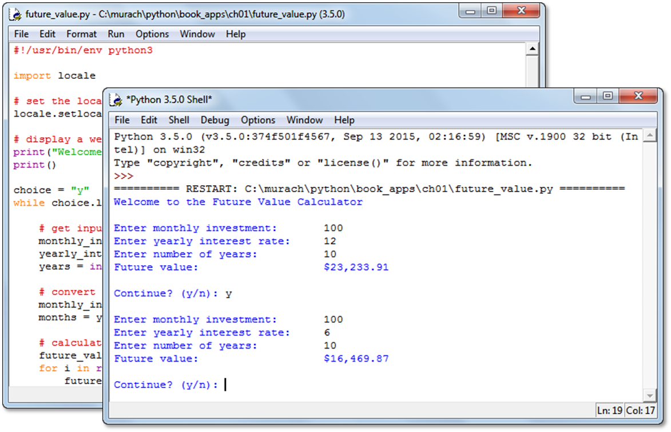
A console application that’s being run in the shell

Slide 23
How to compile and run a Python program
From the editor window, press the F5 key or select Run→Run Module.
If IDLE displays a dialog box that indicates that you must save the program first, click Yes to save it. Then, if the program doesn’t have any errors, IDLE runs the program in the interactive shell.

Slide 24
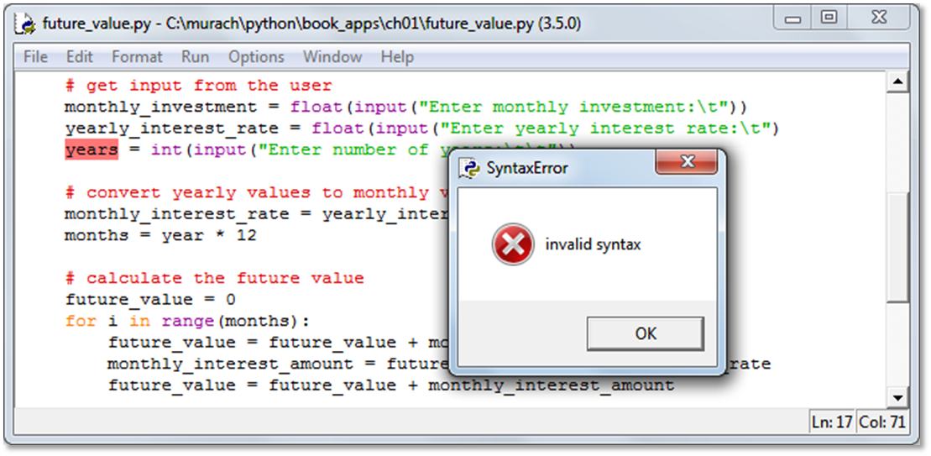
A dialog box for a syntax error

Slide 25
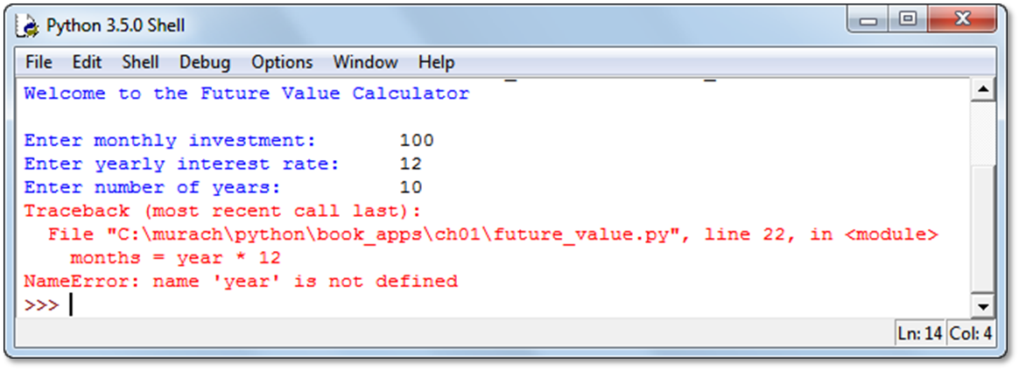
A message that’s displayed for a runtime error

